Slide 1
TWEET EMOTION RECOGNITION
Mehak Jain (209309069)
Perumalla Thushara Meher Siva Mani​
(209302296)

Slide 2
CONTENTS
Abstract
Problem Statement
Objectives
Background Details
System Architecture
Results
Conclusion
Future Prospects
Timeline

Slide 3
Abstract
Social media has recently emerged as a premier method to disseminate information online.
Millions of individuals communicate their thoughts, personal experiences, and social ideals through these online networks. Therefore, we explore the potential of social media to predict human emotions of Anger, Joy, Sadness, etc. We use an inbuilt dataset from hugging face.com and online portal offering pre-processed datasets by taking huge data from various platforms such as Kaggle.

Slide 4
Problem statement
Twitter – a platform where people tend to share their daily thoughts on multiple topics all over the world.
Customers share their reviews of products via tweets. In order to know how the customer feels about their product, the brand needs to go through lakhs of such reviews on Twitter which is impossible manually. Not only brands and companies but the government sometimes needed to check citizen’s emotions regarding a new law or scheme.
So there needed to be a way to automate this process. This is where Emotion analysis comes into play.
The aim of this project is to identify such emotions and classify the tweets according to the same.

Slide 5
objectives
Tokenization of tweets(text)
Converting text labels to numeric vectors
Using padding and truncating on tweets of different lengths.
Creating and using a RNN model with one embedding layer, two bi-directional LSTM layers and one dense layer
Classifying and predicting test set tweets to their emotions such as joy, surprise, love, anger, sadness and fear

Slide 6
Background detail

Slide 7
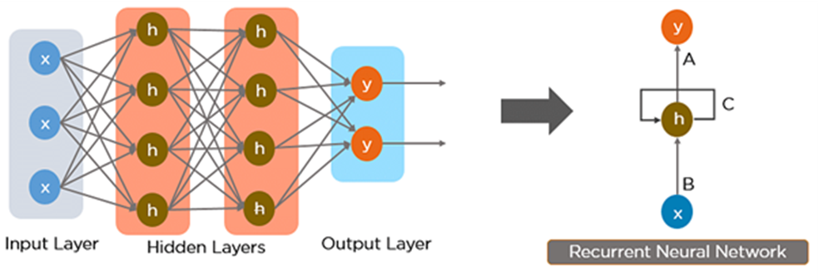
RNN
Recurrent Neural Network(RNN) is a type of Neural Network where the output from previous step is fed as input to the current step.
RNN is used in this project because it is better suited to analyzing temporal, sequential data, such as text or videos.

Slide 8
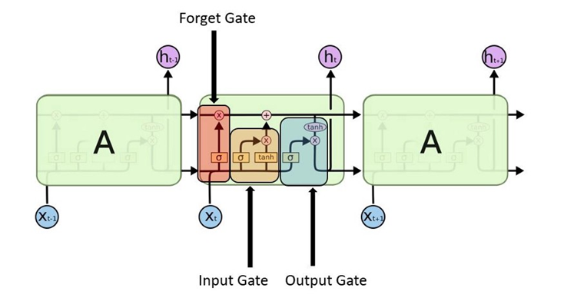
lstm
To solve the problem of Vanishing and Exploding Gradients in a Deep Recurrent Neural Network, many variations were developed. One of the most famous of them is the Long Short Term Memory Network(LSTM).
In concept, an LSTM recurrent unit tries to “remember” all the past knowledge that the network is seen so far and to “forget” irrelevant data.
We have used two Bi-directional LSTM layers in the RNN model we created.

Slide 9
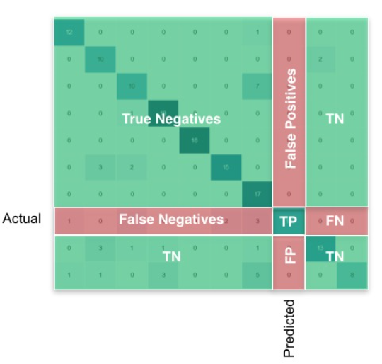
Metrics
Confusion Matrix
It is very informative performance measures for classification tasks.
Ci,j an element of matrix tells how many of items with label i are classified as label j.
The matrix is a good representation for our binary classification. Positive (P) represents toxic label and n (negative) represents non-toxic label.

Slide 10
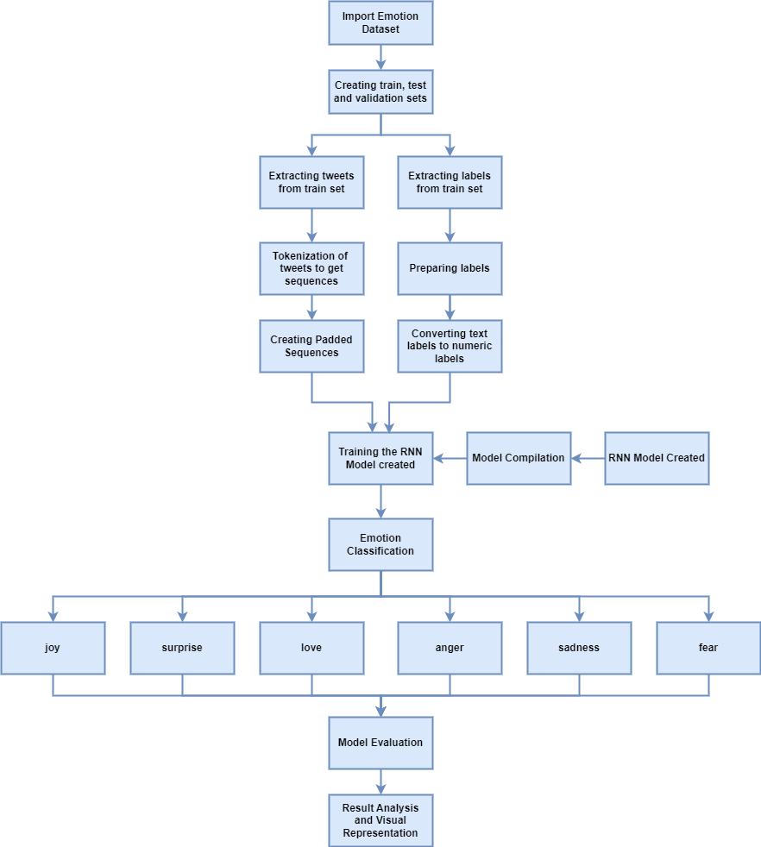
System architecture

Slide 11
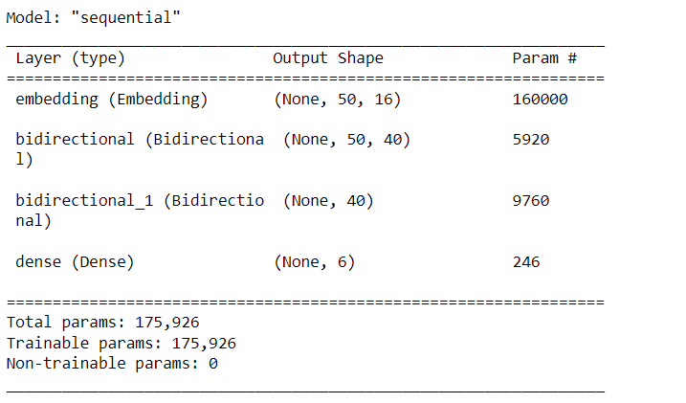
Results
MODEL SUMMARY:-

Slide 12
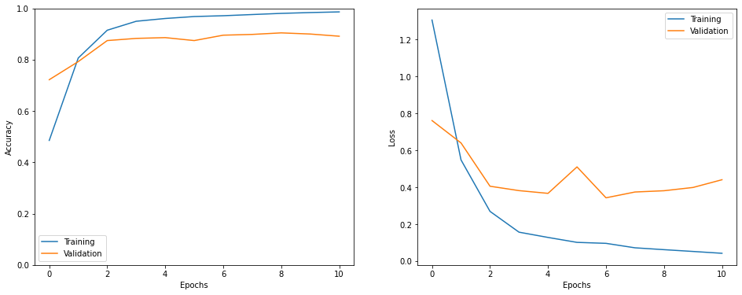
ACCURACY AND LOSS OF TRAINING AND VALIDATION SETS

Slide 13
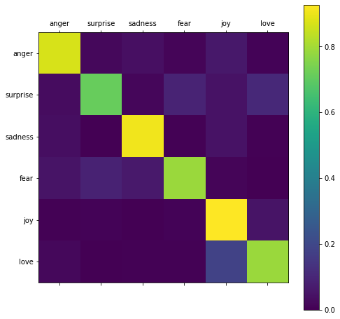
Confusion matrix

Slide 14
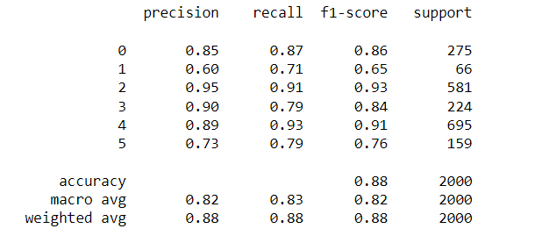
Classification report

Slide 15
Conclusion
We implemented Emotion analysis on the Emotion dataset to classify the tweets into six main emotions such as joy, surprise, love, angry, sadness, and fear using.
We used Recurrent Neural Network(RNN) on the preprocessed tweets and labels. Recurrent Neural Network(RNN) applied on the emotion dataset stands out with overall accuracy 88%.
There are still some limitations of this project as we used 10000 most frequent words only to be tokenized which may contain some repeated unimportant words. This might have reduced our accuracy to a certain level.

Slide 16
FUTURE PROSPECTS
There are still some limitations of this project as we used 10000 most frequent words only to be tokenized which may contain some repeated unimportant words. So the accuracy may somewhat drop due to this. We can solve this problem to some extent using algorithms like TFIDF(Term Frequency Inverse Document Frequency). TFIDF calculates the importance of words used in document. We can use TFIDF to consider the most important words instead of taking frequent words.

Slide 17
TIMELINE
4th September 2022- Deciding on topics of projects
11th September 2022- First initial draft of project
11th to 17th September 2022- Data Exploration
1st to 7th October 2022- Data preprocessing
8th to 15th October 2022- RNN Model
16th to 26th October 2022- RNN Model Evaluation
3rd to 10th November 2022- Results and Analysis
21st to 23rd November 2022- Preparation of project report and presentation

Slide 18
THANK YOU
Mehak Jain
(209309069)
Perumalla Thushara Meher Siva Mani (209302296)

